Slide 1

WINS
Tueor Technologies
Digital Current System
Introduction

Slide 2

The Company
A Major Leap Forward
Tueor Technologies is a privately-held research and development company that specializes in the development and licensing of new and innovative concepts for the aerospace, defense and consumer markets.

Slide 3

Tueor technologies Digital Current System (ttDCS)
What Is It?
  The Tueor Technologies Digital Current System (TTDCS) is a new and patented electronic technology renders all current wiring and electronic control systems obsolete.
  Initially it was designed for use in micro-satellites where every extra gram of mass or additional cubic centimeter of space took away from the amount of payload the satellite could carry into space.

Slide 4
Tueor technologies Digital Current System (ttDCS)
What Is It? (cont)
  Of course, one of the key requirements of a multi-million dollar satellite launch is absolute reliability, and the redundancy that can be designed into the Tueor system virtually eliminates any chance of failure while simultaneously reducing engineering costs and installation time and enhancing system flexibility.

Slide 5
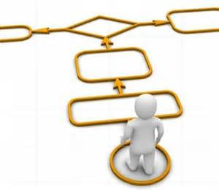
Tueor technologies Digital Current System (ttDCS)
The Problem
  The environment in which land, air or ocean-based electrical and electronic components have to operate and survive can be even harsher and more demanding than the nearly absolute zero, near vacuum of space.

Slide 6
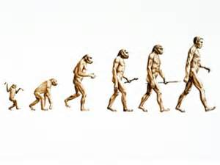
Tueor technologies Digital Current System (ttDCS)
Background
  The TTDCS has been in development for over two decades and represents a composite investment in excess of 30 man-years.
  The technology is currently licensed to a major micro-satellite designer/manufacturer for use in their satellites.
  Additionally, DARPA and the DOD have favorably evaluated the technology to address electrical shortcomings in the Stryker Combat Vehicle.

Slide 7
Tueor technologies Digital Current System (ttDCS)
Background (cont)
  The technology was also favorably reviewed by General Dynamics, AM General, Rockwell International, General Motors, Ford and others.
  ATK, a primary NASA supplier, favorably considered the IC wiring for NASA’s new space shuttle, heavy-lifting, single-stage rocket.

Slide 8

Tueor technologies Digital Current System
(ttDCS)
Basic Technical Philosophy
To provide both variable current (AC, DC or a combination of both) along with bi-directional, high-speed data transfer along a simple common conduit (i.e. twisted pair, coaxial cable, etc.), providing a simple single or multi-loop design to enhance performance and survivability as well as to simplify engineering and maintenance and greatly reduce the amount of wire, control and grounding structures required in any given electrical system.

Slide 9
Tueor technologies Digital Current System (ttDCS)
Basic Technical Philosophy (cont)
  The TTDCS is not a stand-alone product… rather, it is an enabling technology intended to provide a significantly advanced methodology tool to the engineer involved in the delivery of electrical power and control across a defined system.

Slide 10

Power source
PRIMARY
TTDCS
NODE
Local loads and/or controls
Design
Concept
TTDCS
NODE
TTDCS
NODE
TTDCS Loop Design
Nodes can be placed anywhere and moved to any location without affecting any functionality.
Nodes can be added or re-programmed to accommodate future requirements
TTDCS
NODE
TTDCS
NODE
Single Loop of Conduit
TTDCS
NODE
TTDCS
NODE
TTTDCS
NODE
PRIMARY
TTDCS
NODE
Alt Power source

Slide 11
Power source
PRIMARY
TTDCS
NODE
Local loads and/or controls
Design
Concept
TTDCS
NODE
TTDCS
NODE
Break
TTDCS
NODE
The Loop can be opened or shorted without loss of any control or device.
System can self-detect high resistance, shorts, or failures.
TTDCS
NODE
TTDCS
NODE
TTDCS
NODE
TTDCS
NODE
PRIMARY
TTDCS
NODE
Alt Power source

Slide 12
Power source
PRIMARY
TTDCS
NODE
Local loads and/or controls
Design
Concept
TTDCS
NODE
TTDCS
NODE
TTDCS
NODE
Any node, or local area can be destroyed or isolated with no loss of power, feedback or control anywhere else.
TTDCS
NODE
Break
TTDCS
NODE
TTDCS
NODE
TTDCS
NODE
PRIMARY
TTDCS
NODE
Alt Power source

Slide 13
Power source
PRIMARY
TTDCS
NODE
Local loads and/or controls
Design
Concept
TTDCS
NODE
TTDCS
NODE
Break
With the option to bring in alternate power sources anywhere on the system, a loss of one power source has no affect on the system.
Redundant Primary Nodes allow continuous operation after loss of one Primary Node.
TTDCS
NODE
TTDCS
NODE
TTDCS
NODE
TTDCS
NODE
TTDCS
NODE
PRIMARY
TTDCS
NODE
Alt Power source

Slide 14
Power source
PRIMARY
TTDCS
NODE
Design
Concept
TTDCS
NODE
TTDCS
NODE
Local loads and/ or controls
TTDCS
NODE
Redundant loops can be added for better survivability.
Redundant loops will be located geographically separated to minimize chance of losses.
TTDCS
NODE
TTDCS
NODE
TTDCS
NODE
TTDCS
NODE
PRIMARYTTDCS
NODE
Alt Power source

Slide 15
Power source
Ten separate “fatal” electronic shorts or opens will still fail to disable this dual-loop Tueor-based design.
OPEN
PRIMARY
TTDCS
NODE
Design
Concept
TTDCS
NODE
OPEN
TTDCS
NODE
SHORT
Local loads and/ or controls
When shorts or open circuits occur:
As long as Power and Data can find a path to a Node in either direction or along any loop or across other nodes, complete functionality will be maintained.
TTDCS
NODE
OPEN
TTDCS
NODE
OPEN
SHORT
TTDCS
NODE
TTDCS
NODE
OPEN
SHORT
TTDCS
NODE
PRIMARY
TTDCS
NODE
OPEN
DESTROYED
SHORT
Alt Power source

Slide 16

Tueor technologies Digital Current System
(ttDCS)
Advantages
  Bi-directional, self-fusing, self-monitoring,
  fault isolation, facilitates “plug and play.”
  System or chassis ground or both.
  Scales to virtually all power requirements.
  Communication speeds to 100mBaud.

Slide 17
Tueor technologies Digital Current System (ttDCS)
Advantages (cont.)
  Shortens design time:
    Modular design allows for “plug and play” capabilities
    as current and data are provided at any point within the system, component placement is greatly simplified.
    Integrated Vehicle Health and Telemetry are already built into the system.

Slide 18
Tueor technologies Digital Current System (ttDCS)
Advantages (cont.)
  Reduces or Eliminates the need for numerous ancillary structures:
    Eliminates the need for conventional grounding.
    Eliminates the need for conventional fusing.
    Eliminates the need for identical, redundant wiring.
    Eliminates the need for parallel control structures.
    Eliminates the need for separate telemetry.
    Eliminates the need for vehicle-health monitoring.

Slide 19
Tueor technologies Digital Current System (ttDCS)
Advantages (cont.)
  Uses less wire and fewer electronic components.
  Easily accommodates redundancy and shared command responsibilities.
  Distributed Intelligence decreases the need for ultra-high communications speed and solves the current problem
  of limited band-width restrictions while enhancing the
  entire electrical system’s capabilities.

Slide 20
Tueor technologies Digital Current System (ttDCS)
Advantages (cont.)
  Uses “off the shelf” components (depending on environment and design applications).
  Adaptable to multiple communications and software protocols.
  Uses a simple, basic 9-bit communications protocol as
  its normal operational structure, but is adaptable to other
  or specialized protocols

Slide 21
Tueor technologies Digital Current System (ttDCS)
Advantages (cont.)
  In internal lab tests, The TTDCS generates minimal EMI over a range of power levels significantly beyond the normal range of those power levels found in similar applications.
  Additionally, independent lab tests demonstrates the technology’s exceptional resistance to exterior or artifact EMI.

Slide 22

Tueor technologies Digital Current System (ttDCS)
Independent Lab Evaluations
Demonstrated robust resistance to both AC and DC interference and artificially generated “noise.”
Dr. John Palmer, PhD EE, world-renowned expert on forensic and failure analysis, conducted the first independent evaluation of the technology.
His reaction was to term the technology as “Extraordinary”.

Slide 23

Tueor technologies Digital Current System (ttDCS)
Special AC Considerations
  The TTDCS can deliver and control AC power directly to any AC motor on its system through the inclusion of an inverter or bridge driver between the TTDCS node and the device.
  Additionally, the TTDCS can control an AC-powered motor by including the capability of an AC motor controller directly to or in conjunction with its system node.

Slide 24
Tueor technologies Digital Current System (ttDCS)
Special AC Considerations (cont.)
  All critical aspects of AC motor operation can be monitored.
  The previous AC considerations do not represent all available options for power delivery and control for AC power.
  Single- or multiple-phase AC control capabilities, similar to the DC control capabilities of the TTDCS.

Slide 25

Benefits of the ttDCS
Reduced warranty
Shortened design time
Simplified design
Material reduction (wires, connectors, components)
Reduction of installation labor
Dramatically improved Quality

Slide 26
BENEFITS OF the ttDCS
Redundancy and robustness
Easier repair and maintenance
Flexible for future modifications/added services
Poke Yoke (error-proof installation)
Scalable
AC and DC compatible
Self monitoring for vehicle health

Slide 27

Tueor technologies Digital Current System (ttDCS)
The Opportunity
  The immediate, proven opportunity is Defense, Civilian Vehicles, Aerospace and Homeland Security.
  The TTDCS wiring has already been identified by DARPA, NASA and the DOD as a highly reliable, flexible, survivable and maintainable electronic technology for weapons systems, military vehicles, aircraft and naval vessels.

Slide 28
Tueor technologies Digital Current System (ttDCS)
The Opportunity (cont)
  Every car, truck, boat, robot or airplane built today can benefit from this technology.
  Use of this technology will result in reduced complexity, cost and weight with huge gains in reliability and flexibility.
  The technology can be easily integrated into new applications at the beginning of the design cycle

Slide 29

Tueor technologies Digital Current System (ttDCS)
Tueor TECHNOLOGIES – A Short History
Tueor Technologies is the new embodiment of an original parent company, IC Technologies.
IC Technologies was founded by two Vietnam veterans, one Navy and one Air Force.
No strangers to the demands of both aerospace and today’s new high-tech defense capabilities, they have collaborated to produce an impressive record of original and cutting-edge technologies.
Their motto: We make the impossible….practical.

Slide 30

Tueor technologies Digital Current System (ttDCS)
Tueor Technologies Primary Inventors
Dr. James M. Hair III
  Primary Inventor, Physicist
  25+ years working with NASA, Siemens, Hewlett Packard and Texas Instruments, among others.
  Former University Professor.
  Holder of numerous patents in the medical, scientific and electronics fields.

Slide 31
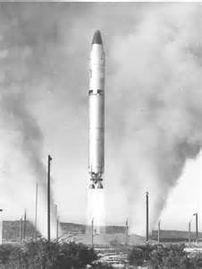
Tueor technologies Digital Current System (ttDCS)
Tueor Technologies Primary Inventors
Dr. Daniel L. Greene, PhD (abd)
  Computer Scientist and co-developer.
  20 years experience with ICBMs.
  Former University Professor.
  Retired Military Man.

Slide 32
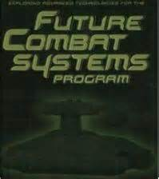

Projects and systems already identified and evaluated for ttDCS
The Future Combat System (FCS) technologies are suffering from lack of standardization, modularity, interoperability and programming-glut.
The TTDCS is inherently designed as a viable answer to these and other problems facing our future forces.

Slide 33
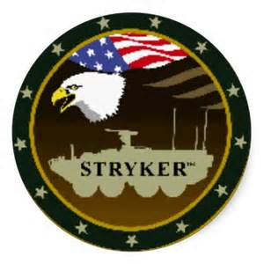
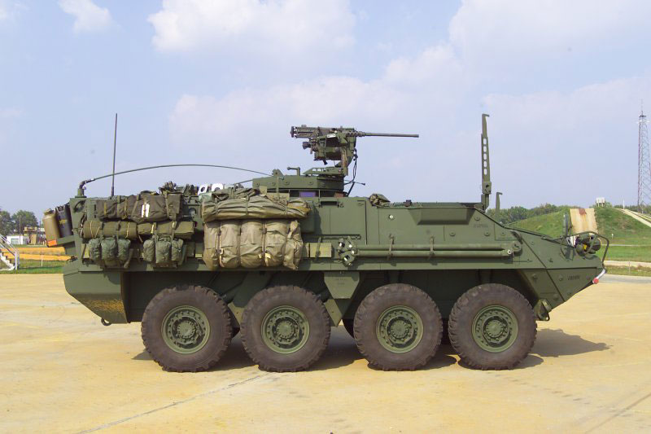
Projects and systems already identified and evaluated for ttdcs
An example of the potential benefits of the TTDCS system is the Stryker Vehicle.
Tueor was contacted by a contract-engineering firm to assist them in overcoming recently identified electrical system failures.

Slide 34
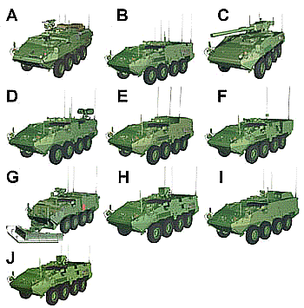
Projects and systems already identified and evaluated for ttdcs
The Stryker is adaptable to many different combat roles, and employs some of the world’s most advanced electronics in order to “switch” from
one capability to another.
Using current technology, this is a time-consuming and dangerous operation in-theater.

Slide 35
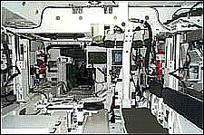
Projects and systems already identified and evaluated for ttdcs
As you can see, within the interior of the Stryker, space is at a premium. Originally designed electrical pathways have proven inadequate.
Tueor was asked to solve this problem.

Slide 36

Projects and systems already identified and evaluated for ttdcs
By using the capabilities of the TTDCS, we were able to reduce the associated mass and components of 2 of the 3 major electronic sub-systems; one by over 80% and the other by close to 60%, while enhancing vehicle system survivability by over 125%

Slide 37

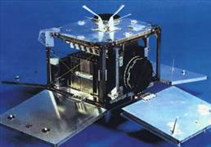
Projects and systems already identified and evaluated for ttdcs
The TTDCS also has been licensed to a DOD sub-contractor for integration into Micro-Satellites to decrease associated mass as well as enhance unit survivability and mission flexibility.

Slide 38

Projects and systems already identified and evaluated for ttdcs
Within the “flock” concept of the DOD, design, flexibility, modularity and reliability are absolutely necessary.
The TTDCS provides all of these attributes and more.

Slide 39
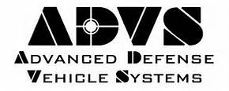
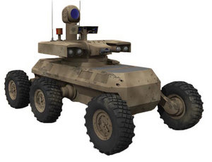
Projects and systems already identified and evaluated for ttdcs
The designers of the new Army MULE has agreed that the very multifunctional capability demanded by the MULEs concept is readily addressed by the TTDCS while increasing the vehicles health and tactical telemetry, survivability and autonomous operation.

Slide 40

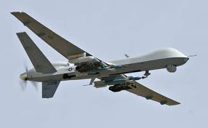
Projects and systems already identified and evaluated for ttdcs
The weight/mass reduction capability of the TTDCS electronics system, along with it’s exceptional survivability makes it the technology of choice for applications requiring high reliability and recoverability such as the Predator Remote Controlled Aircraft, with the added benefit of vastly reduced logistical requirements due to simplified hardware nomenclature.

Slide 41

The logical evolution of the ttdcs technology philosophy
Using the TTDCS concept as an enabling technology, Tueor has designed the first fully secure computer system.
It is based on a hardware solution that is completely impervious to any form of real-time hacking or time-delay intrusions.

Slide 42


Tueor Technologies Advanced concept security (ttacs) computer system
The system is based on the dual-pronged concept of using distributed computing while physically cloistering anything that could infect or attack any program.
(The only way the TTACS workstation or server-driven system can be violated is through the active participation of the operator, or a physical break-in to the system itself)

Slide 43
Tueor Technologies Advanced concept security (ttacs) computer system
Computing has evolved to a state of massive central processing driven by powerful, extremely fast, reasonably priced microprocessors… this is complemented by memory that has experienced exponential increases in capacity with significant reductions in cost and physical size.
This powerful central processing capability has fostered extremely complex operating systems and application interfaces which have created the perfect camouflage environment in which ‘hackers’ can function.
The only current defense against remote cyber attack other than cloistered isolation is software and since all software can be defeated by newer software there exists the continuing spiral of security software being layered on hacking software, etc., etc., and so on.

Slide 44
Tueor Technologies Advanced concept security (ttacs) computer system
Cyber crime has increased 4000% since 1997 (Carnegie-Mellon CERT)
50 million Americans suffered identity theft from 2002-2009 (FTC)
1 in 10 emails infected with ‘backdoors or Trojans”-RATS- (OECD)
OECD estimates that 400 million PCs controlled by RATS globally
“…We know from reliable intelligence that terrorist groups are not only using cyber-crime to fund their activities, but are studying how to use information attacks to undermine critical US infrastructures” (K. Silva, CoB, Internet Security Alliance)

Slide 45
Tueor Technologies Advanced concept security (ttacs) computer system
Iron-clad security benefits.
No TTACS system can be infiltrated or changed without the direct active support of the operator.
No active hacking is possible.
No time-delayed access to any program is possible.
Protection for the system is HARDWARE based…not SOFTWARE based, hence no possibility of outside attack or intrusion via connectivity.
Distributed processing eliminates central processor; immediate boots.
Imminent scalability Limitless multitasking.
Operates across all known platforms.

Slide 46
Tueor Technologies Advanced concept security (ttacs) computer system
Significant financial benefits.
Eliminates $100s Billions annually spent on anti-hacking activity.
Eliminates repetitive hardware upgrades.
Software can be upgraded selectively.
Overall cost of TTACS system is lower than current benchmarks.
Less need for massive processors.
Commodity costs for most components.
Eliminates costs of actual losses due to hacked information.

Slide 47
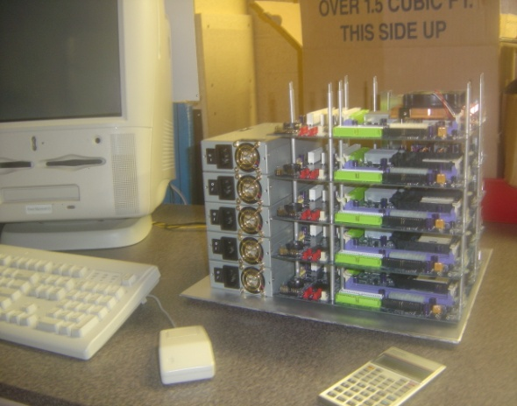
Tueor Technologies Advanced concept security (ttacs) computer system
The current prototype application is undergoing a series of tests and simulations to verify the design and functionality of the TTACS design philosophy.
While continuously connected to the internet for over 9 months, a challenge to “hack” the computer was issued with a financial reward to be given to any successful attack.
To assist the “hackers” the computers IP address, sign-in password, and target file name and location were provided.

Slide 48
Wins advanced concept security (wins acs) computer system
Over 400,000 “hits” were recorded world-wide, without a single successful intrusion into the computer, even though it was used every day for routine work.
We know of NO OTHER computer, software or security company in the world that has issued,
much less survived, such a challenge since they already know that their software security systems are always vulnerable. Our hardware-based security system is not.

Slide 49

Tueor Technologies Advanced concept security (ttacs) computer system
The information and lessons learned from this Alpha test have allowed us to continue to logical evolution of the technology, as it relates to computer design and performance.
In the near future, we should be able to provide TTACS-based secure computing environments to entire systems and networks world-wide.
Through HARDWARE not SOFTWARE based protection, true cyber-security may be achieved.

Slide 50

New opportunities
Recently, Tueor has been contacted by a legal consortium aware of the capabilities of the Tueor technologies and interested in proactively addressing a new and potentially deadly threat to not only the American Public at large, but also the manufacturers of internal and external medical appliances.
Recent policy statements from the U.S. Food and Drug Administration (FDA) has dictated that manufacturers of medical appliances must take immediate and effective steps to prevent the potential of “life hackers” being able to affect or spy on individual medical appliances.

Slide 51
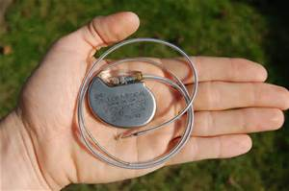
The deadly potential of
“life hackers”
Basically, most implanted medical devices (such as the heart pacemaker/defibrillator pictured above) are, in many ways, just little computers that monitor and control a vital organ.
These life-saving units also record and upload vital data on the patient’s health and condition, as well as being able to deliver an electrical “shock” to the heart, if necessary to maintain a proper heartbeat.

Slide 52

The deadly potential of
“life hackers”
Several incidents in the past year have now demonstrated the unfortunate fact that “hackers” can potentially affect the operation of medical devices, pirate the medical information they contain, or even hold the recipient of the device, the recipient’s doctor and even the medical device manufacturer to ransom with the threat of causing an implanted device to malfunction, injuring or killing the recipient via “remote control”, while remaining anonymous.
This may sound a bit far-fetched……IT IS NOT!!!

Slide 53
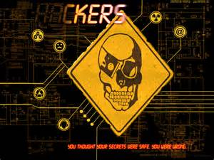
The deadly potential of
“life hackers”
This threat is already real, hospitals have recently been forced to pay millions of dollars to “cyber-pirates” to recover or protect patient’s medical records.
The technology to “hack” and/or control implanted medical devices is already available. The only thing keeping this disaster in medical treatment from happening right now is one of logistics, being close enough to affect a given appliance in real time.
This hurtle is rapidly disappearing as more and more appliances use remote telemetry to accomplish their design function.

Slide 54

The deadly potential of
“life hackers”
According to the U.S. Inspector General’s office, we are not only close to the point to where pirates and terrorists could have the ability to kill people, we are already there.
The demonstrated success of being able to hold health providers data to ransom has encouraged other nefarious individuals to begin working on this threat in earnest.
We realistically could be on the verge of an unprecedented crisis in health care and personal safety.

Slide 55
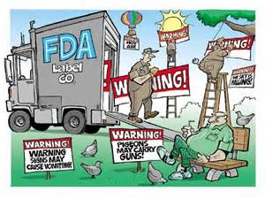
The deadly potential of
“life hackers”
Unfortunately for the public, the “guidelines” that the FDA has provided raise more questions than they answer, do not provide a clear path to compliance, set no measurable standards of safety or performance and basically leave the attainment of these “guidelines” up to the manufacturers in a more or less “sink or swim” manner.
The manufacturers and designers are left in a quagmire of uncertainty and potential litigation if patients begin to die from cyber-hacking and they are not able to demonstrate that they have properly adhered to the “guidelines” adequately.

Slide 56
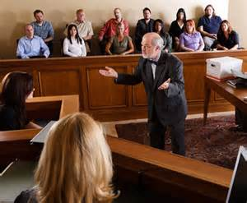
The deadly potential of
“life hackers”
This situation has led to the probability of massive and expensive litigation against medical appliance manufacturers and health care providers if and when “life hacking” begins to occur in earnest.
As the assistant head of the Government Accounting Officer said: “Experience has shown us that the criminal intrusion into the operation and control of medical appliances is not a case of if, but when, and we are woefully unprepared for the consequences”.

Slide 57

The deadly potential of
“life hackers”
Currently, manufacturers are attempting to provide security to medical devices using the same tactics as generally used in traditional computers…which is the use of more and more complicated software.
If the failures of traditional computer security show us nothing else, it is that the old saying is still true:
“There never has been, is not now and will never be a piece of software that another piece of software cannot eventually overcome.”

Slide 58

The deadly potential of
“life hackers”
Due to our demonstrated ability to provide a safe and secure cyber-environment via hardware….not software…. innovations, it is possible that the cyber-secure design for medical appliances that Tueor has already developed could realistically become the new standard for medical appliance security.
At this time, according to Governmental sources, there is no other identified technology or company that has demonstrated our capabilities and abilities.

Slide 59

summary
  The Tueor wiring technology is a breakthrough for every type of land, air and sea form of transportation, communication and control.
  It’s simpler, lighter, and saves critical space
  It’s less costly and more reliable than any other system on the market today.
  It has the potential to become ubiquitous in any electronic system using power, communications or control.

Slide 60
summary
  It not only detects problems, if one should occur, but also it can be programmed to tell a technician exactly what the problem is and where it is occurring.
  Huge savings in time and cost for both the manufacturer and the consumer.
  Simplified design, maintenance, upgrading, logistics and control structures equate to greater efficiency, less down-time and enhanced security.

Slide 61
summary
Using the unique capabilities and robustness of the WINS DCS system, we have also demonstrated that this breakthrough in electronics technology also possesses the potential to solve one of the most important and insidious problems of our time….cyber-security, since the Tueor Security Computer has already demonstrated its invulnerability before a world-wide audience.

Slide 62
summary
The capabilities of Tueor Technologies is also beginning to be recognized by Governmental and Legal entities as a possible answer to life-threatening criminal activities.
There exists the very real possibilities that, in the absence of any other demonstratively effective technologies, the Tueor-Based Wires could become a federal standard in several military and health-care applications.

Slide 63

Developed and Authored by Daniel L. Greene
Dan may be reached at AGEELA61@gmail.com or
(307)635-1160

